Slide 1


Ashurst CE Aided Primary School
Climate Action Plan
September 2026 – due for review September 2027
Our aim:
We take pride in ‘achieving together with love, hope and joy’ and we will proactively engage pupils, staff, parents, governors and the wider school community in our efforts to encourage biodiversity, conserve water, support sustainability, reduce our carbon footprint and, ultimately, act as custodians for our world.
Our target areas:
Decarbonisation – improving energy efficiency across the school to reduce our carbon footprint
Biodiversity – increase knowledge and support sustainability through planting and wildlife habitats
Adaptation and Resilience – promoting water conservation
Climate Education and Green Skills – commitment to Net Zero aspirations and nurture a sustainable future

Slide 2
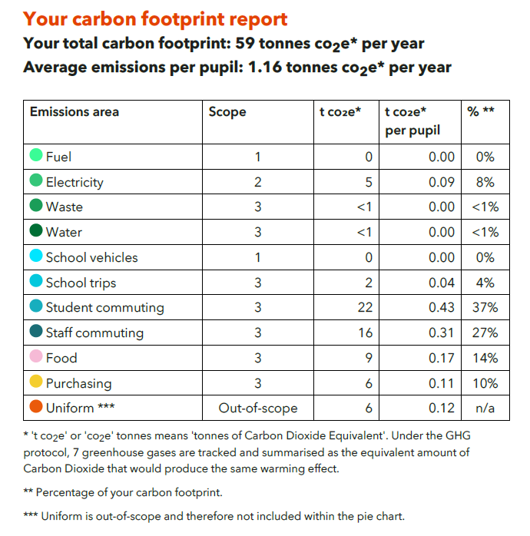
Data from report run in September 2026

Slide 3
What has been achieved to date?
We signed up to the Let’s Go Zero campaign and completed the Count Your Carbon exercise in March 2025 and again in September 2026.
In March 2025, our fuel usage was 11% of our carbon footprint at 9.7 tCO2e per year, and electricity was 5% and 3.9 tCO2e.
Since the removal of our oil heating system and installation of two air source heat pumps in August 2025, the emissions relating to electricity have increased slightly to 8% and 5 tCO2e, but there are now no fuel usage emissions.
This has been a significant step in reducing greenhouse gases, lowering energy use through high efficiency, and maintaining a consistent ambient temperature in the school building.
The costs have been similar:
Aug2024 to Jul2025 oil and electricity £5,700
Aug2025 to Jul2026 electricity only £6,140

Slide 4
What else have we achieved, and continue to implement?
Insulation of loft space above Headteacher’s office
Replacement of window frames in Mouse Class to eliminate draughts and prevent heat loss
Supporting car sharing as most pupils are driven to our rural school
Recycling bins in all classrooms, office and staff kitchen
Children shown how to reuse clean plastic milk bottles as watering cans
Creation of mud kitchen and benches by parents from upcycled materials such as pallets and wood
Low water use urinals to reduce flushing water
All lighting, PCs, laptops and smartboards switched off when not in use
Point-of-use hot water tap in staff kitchen used instead of kettle
Second-hand uniform available, as well as non-logo items to make uniform accessible
Signed up to Bag2School scheme - collecting and reusing textiles
Books – often sourced from second-hand suppliers, and pre-loved books sold back to them, particularly those businesses that are mindful of sustainability and their carbon footprint
Gardening Club – composting fruit peelings from the Schools Fruit and Vegetable Scheme, making goods from appropriate foraging, garden produce to support The Wholesome Warehouse, planting trees, and learning about creatures such as worms that have key roles in their own wildlife environments
Bird boxes installed in trees in Kings Grove
Litter picking to raise awareness of protecting our local area by keeping it tidy
Stewardship at St. James’ church – carrying out surveys of flora and fauna and monitoring changes

Slide 5
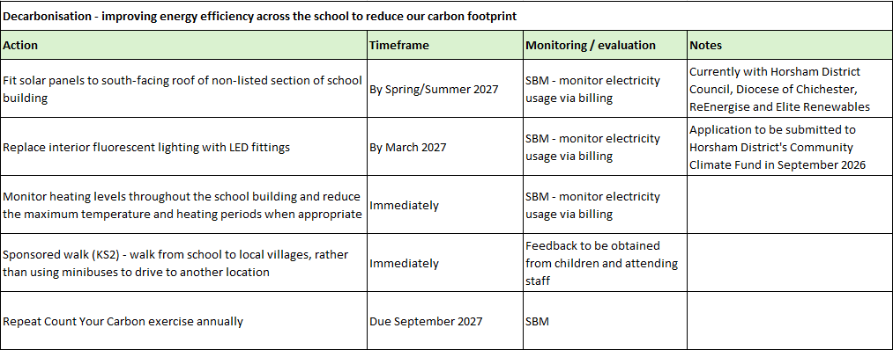
What else can we do? Our Climate Action Plan:

Slide 6
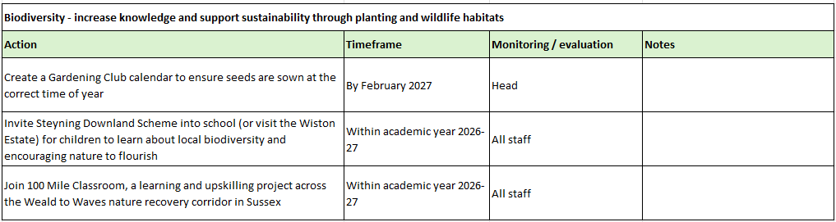
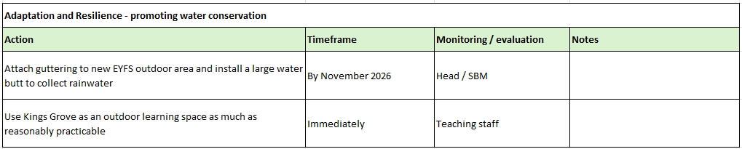

Slide 7
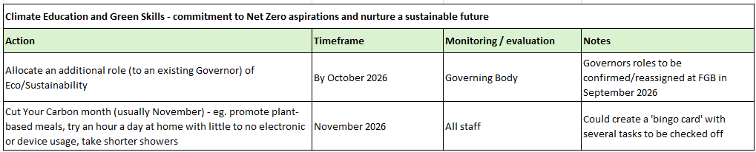
Due for review September 2027

