Slide 1
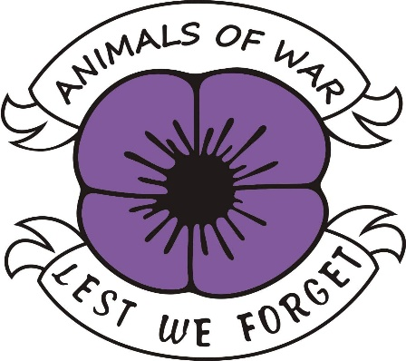
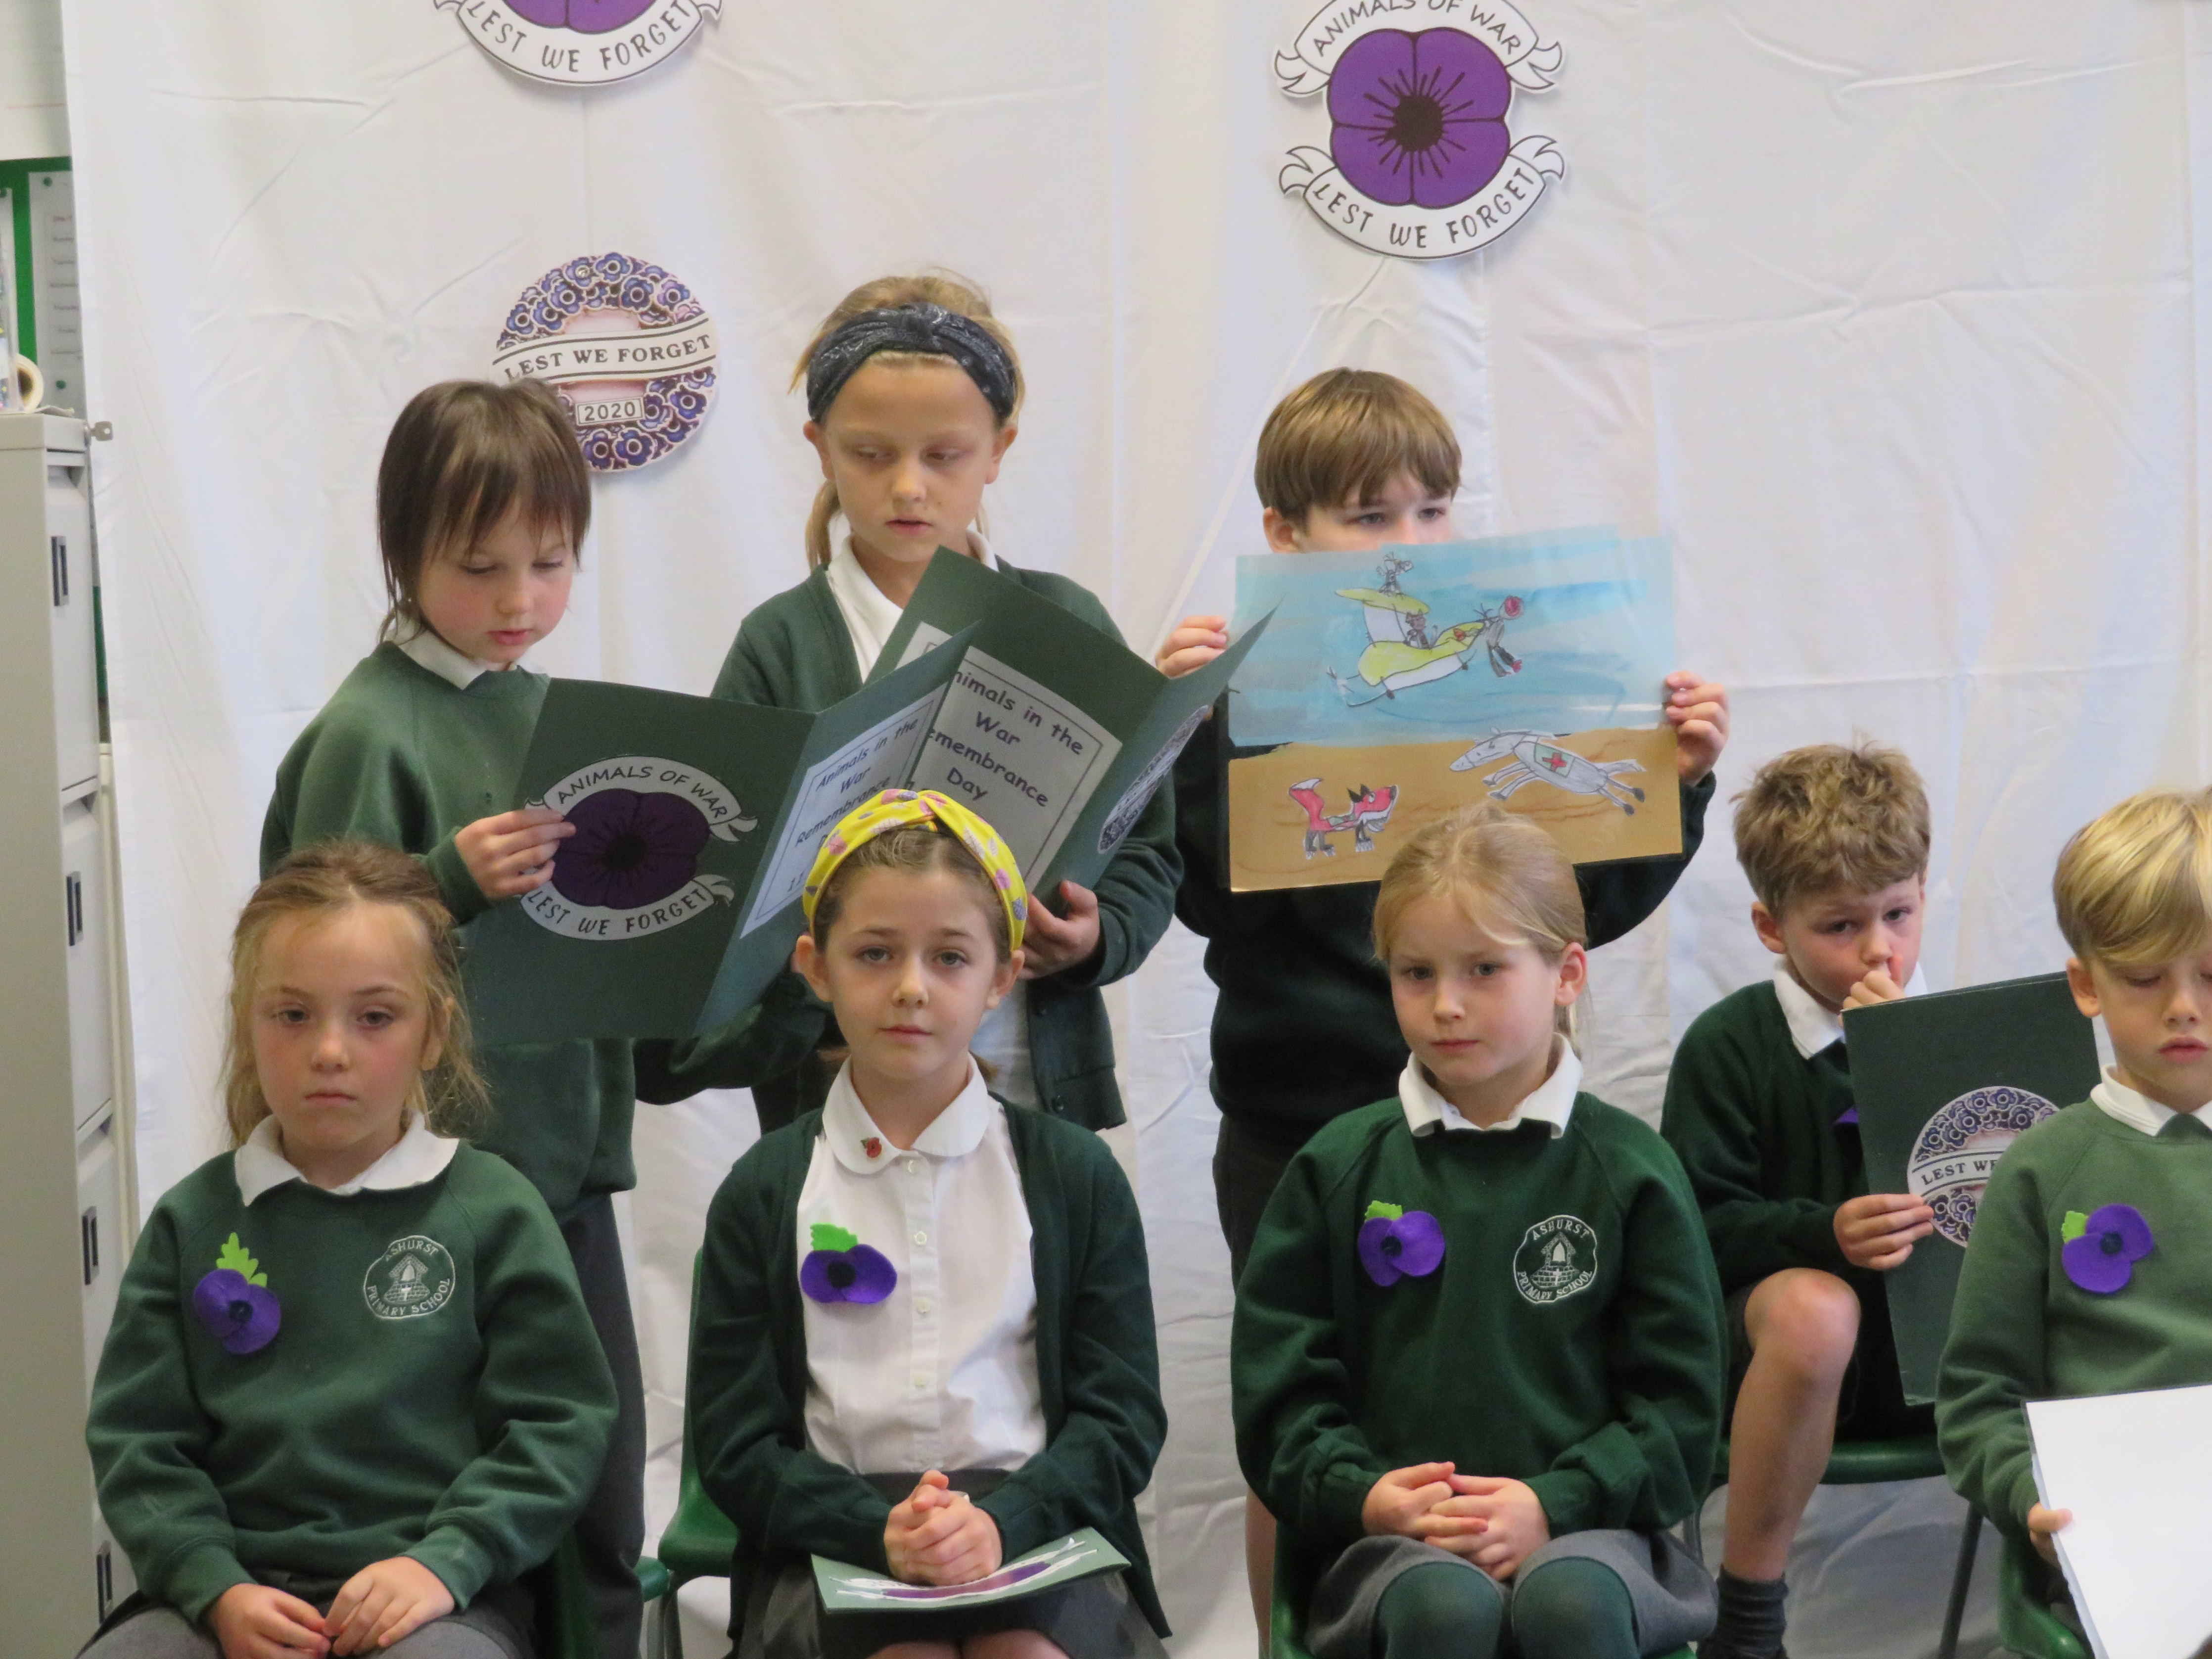
Animals in the War
Y3&Y4 Remembrance Day Assembly
11.11.20

Slide 2
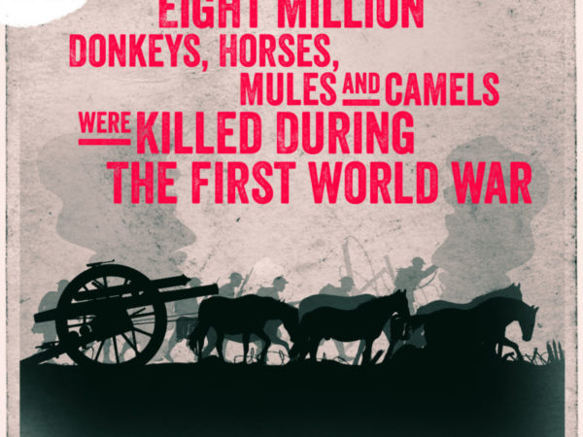
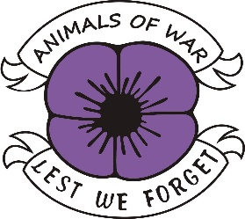
1914-1918 – First World War
Did you know that Britain had over one million horses and mules in service during WW1?
In this war Britain lost more than 484,000 horses.
7,000 horses died in one day alone at the Battle of Verdun
The British Army Veterinary Corps gained the ‘Royal’ prefix for its efforts in helping animal who were suffering.
This was the first war to have a vets in service.

Slide 3
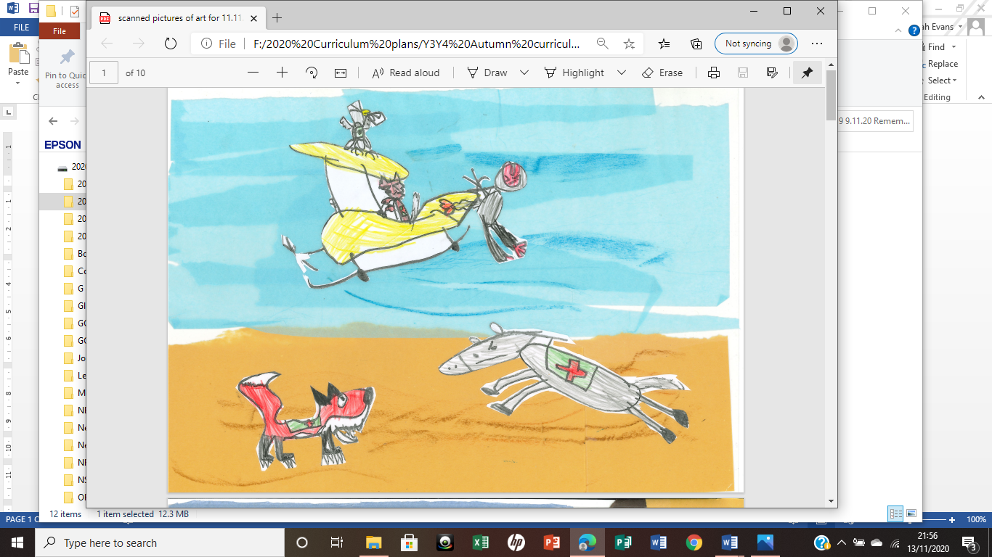
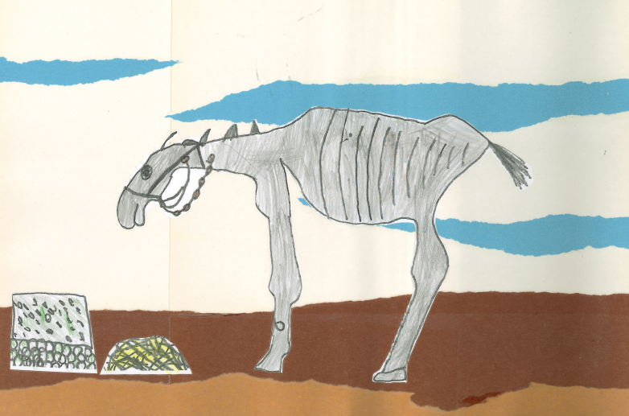
1939-1945 – Second World War
Did you know that Britain was the first nation to motorise its army, and began to replace horses with vehicles in 1928?
The British Army still employed 6,500 horses, 10,000 mules and 1,700 camels.
In total, 200,000 animals – also including dogs and pigeons – were put into service by Britain.
The British and Japanese in Burma used elephants for transport, building bridges and roads, and for pulling trucks out of the mud.
The German Army lost 179,000 horses in two months.

Slide 4
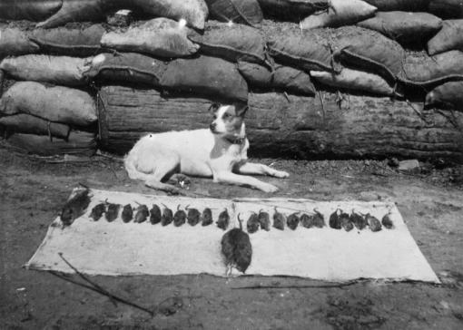
2001-present – War in Afghanistan
Dogs still work with and support the British Special Forces operations.
Today there are about 11,000 dogs working with the armed forces.
The UK Ministry of Defence said the role of these dogs
‘cannot be underestimated.’

Slide 5
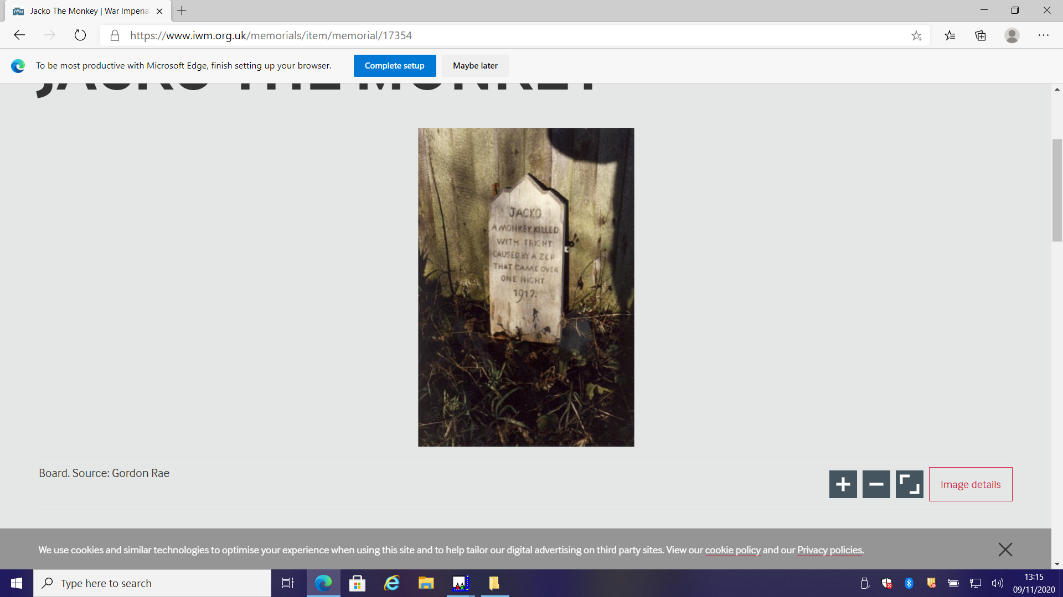
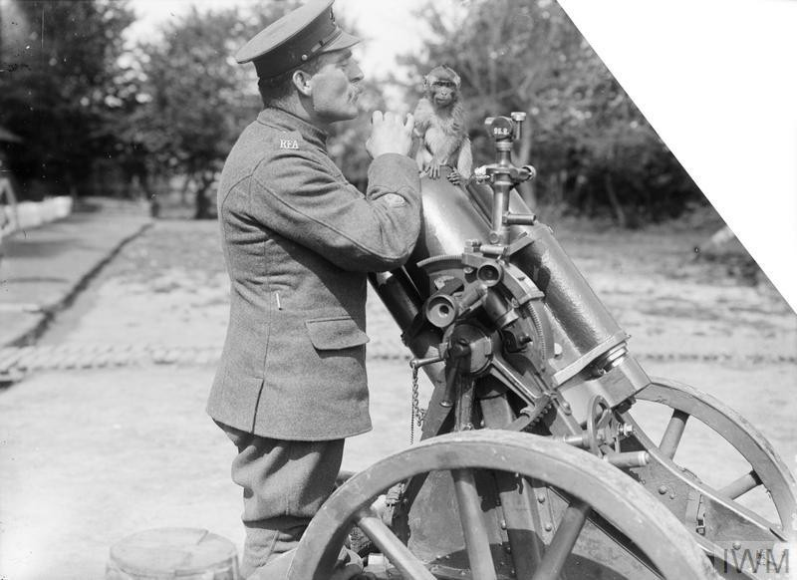
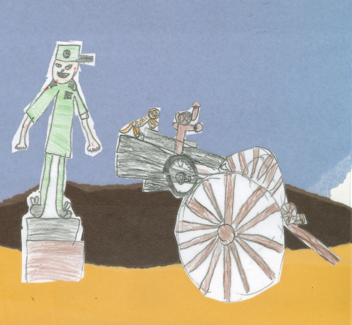
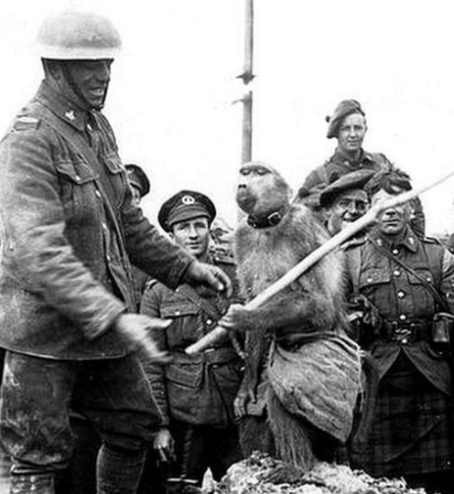
Monkeys and Baboons
Did you know monkeys served with soldiers and kept them company when they were injured or had lost a friend at war? The soldiers liked the monkey because he was cute, loving and comforting. There was one special monkey called Jacko who lived in a bunker. But one night a Zep came over and obliterated the hide out. (A Zep is a Zeppelin which was a big air ship.) Sadly Jacko was killed, but the soldiers loved Jacko so much that they made him a wooden grave and buried him.
There was also a baboon called Jackie who had excellent eyesight and hearing. When the enemy was close she would tug at their clothing and make noises to keep the soldiers alert. She was promoted to a corporal in the army for her excellence.

Slide 6
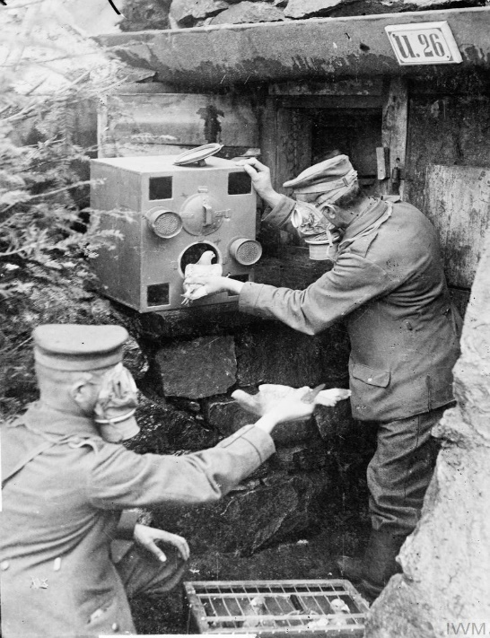
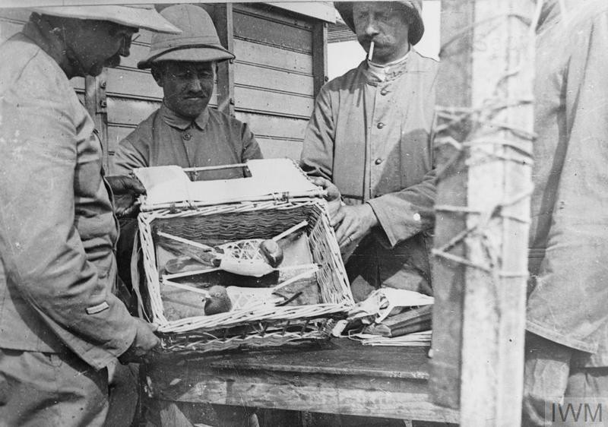
Did you know that in the war 100,000 homing pigeons carried messages to and from the trenches?
Some pigeons were shot but still made it to where they were taking messages to. One pigeon was shot in the left eye whilst carrying a message for the British but still delivered the message.
The RAF tracked a pigeon that flew 22 miles in 22 minutes- that is flying at 60 miles an hour! This pigeon delivered a message that helped with rescue of two wrecked seaplane pilots.
In the Battle of Amiens pigeons
were released from a port hole
in the sides of tanks. One famous
pigeon was called ‘Dreadnought’, it
carried hundreds of messages safely.

Slide 7
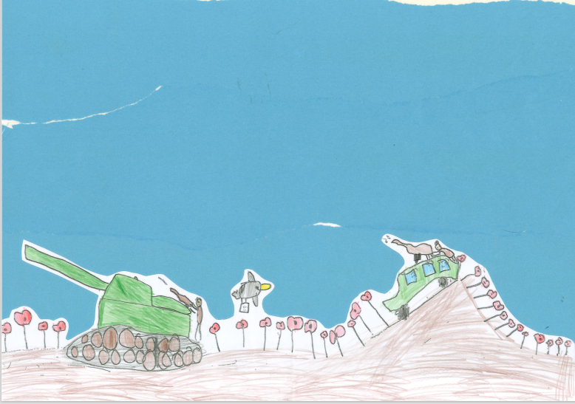
Joshua’s picture shows one of the pigeons that flew from tanks and carried it’s message across a field of poppies.

Slide 8
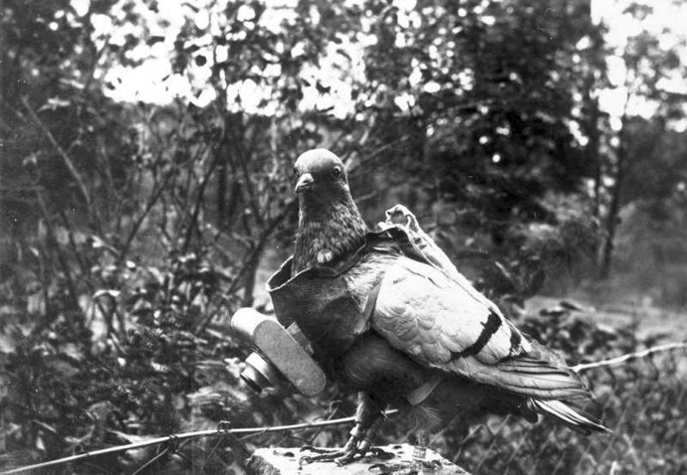
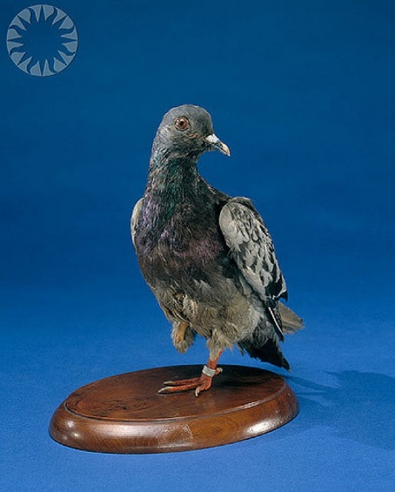
Another famous pigeon was sent by Skipper Thomas Crisp for help when he was attacked by German U-boats in August 1917. The pigeon delivered the message in time but Crisp was killed.
Another pigeon carried a letter a very long way and it saved four lives. Sadly the pigeon died of exhaustion soon after it had delivered the letter.
Some pigeons had cameras so they could film what the enemy were doing.
Cher Ami
One Pigeon was named Cher Ami (Dear Friend) and was awarded a medal for her help in saving 194 American soldiers trapped behind German lines in 1918.
She made it back despite having been shot through the chest, blinded in one eye, covered in blood and with a leg hanging only by a tendon.

Slide 9
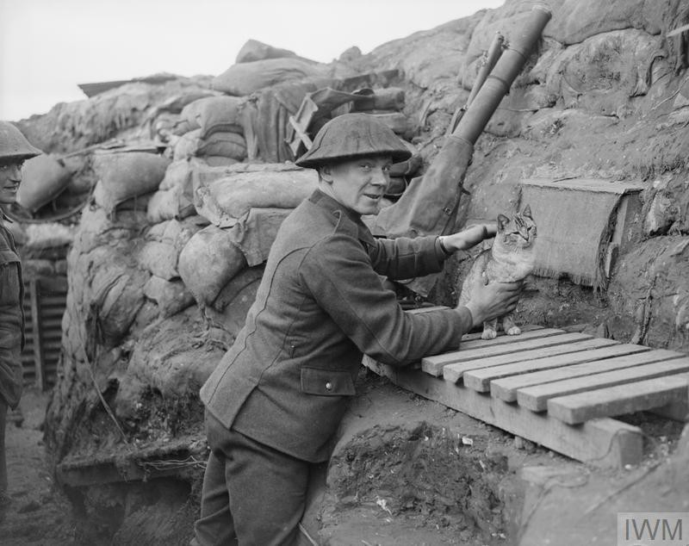
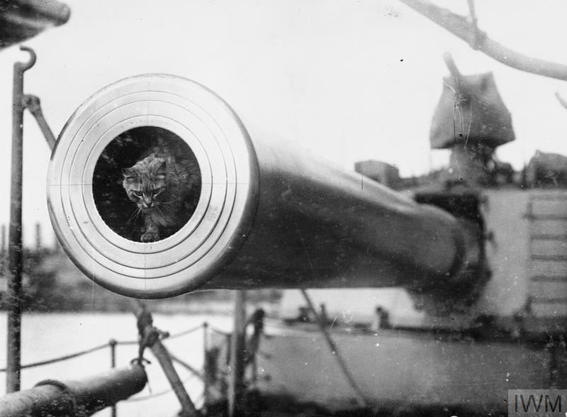
Cats
Some cats were mascots in the war, soldiers that were fighting in the trenches liked it when they could go and stroke or play with the cats after a long day.
Other cats were very useful. They were used by the Navy on their boats and were good for catching rats and mice. If the cats weren’t there the rats would have eaten the sailors food and chewed their ropes.
Cats also caught mice and rats in the trenches that would have eaten the soldiers’ food.

Slide 10
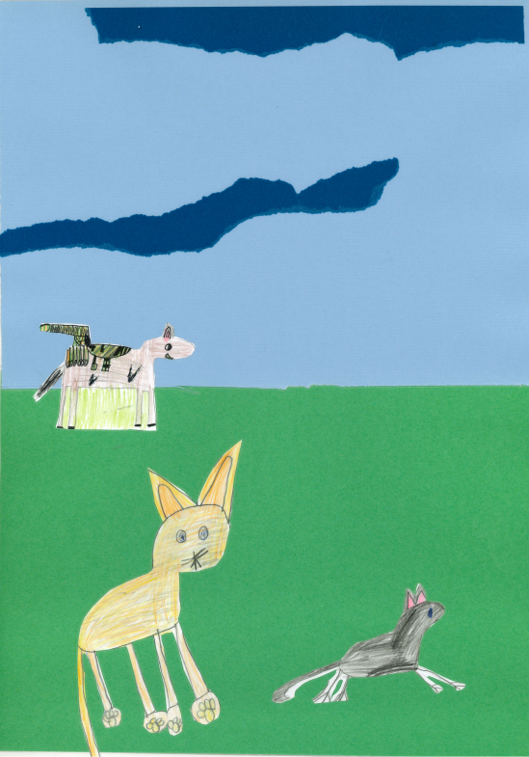
We used different torn papers and card to make our background.
This picture shows a cat chasing a rat and a horse carrying weapons in the background.

Slide 11
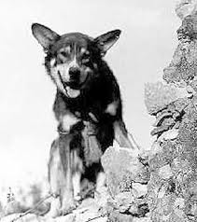
Dogs
One of the most popular dogs used in the war were German Shepherd dogs- they also called Alsatians.
Casualty Dogs
Casualty dogs were trained to find wounded or dying soldiers on the battlefield, They carried medical equipment so an injured soldier could treat himself and the dogs would also stay beside a dying soldier to keep him company.
Famous Dogs
Chips – there was a famous dog called Chips in WW2.
He was a collie/ German shepherd/ Siberian husky mix.
He served in Germany, France and North Africa.
He helped take 10 Italian soldiers prisoner when he
took over a machine gun station.
This is Chips.
Kaiser
Kaiser was a famous German Shepherd in WW2. She was the first dog killed in action in the Vietnam War.

Slide 12
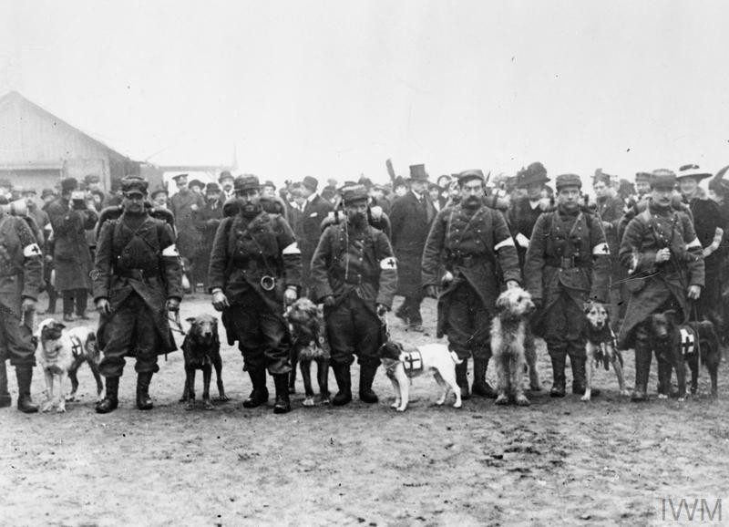
Dogs
Nemo
Nemo was a famous German Shepherd he was in WW2. He was shot in the eye but he still attacked the enemy and protected his owner. Nemo and the soldier survived the attack.
Smoky
Smoky was a Yorkshire terrier and in WW2 her very good hearing warned soldiers of incoming artillery shells.
Stubby
Stubby was an American pit bull terrier she was very famous because she could smell poisonous gas when it was coming and warn the soldiers.
French casualty dogs lined up for inspection.

Slide 13
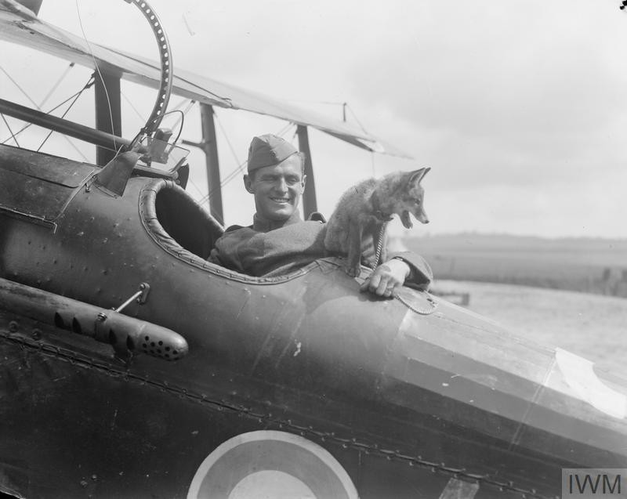
Dogs
As you probably know, dogs had an important role in the war and I’m going to tell you a little more about what they did. Dogs were some of the most hard working and trusted animals who helped in the war. The most popular breeds were medium sized like Doberman Pinschers and German Shepherds.
Guard dogs stayed close to one soldier or a group and were taught to give a warning sound such as growling or barking when they sensed a stranger close to the camp.
Dogs carried help to the wounded and took messages. They sniffed out the enemy and even helped to lay telephone wires! They caught rats in the trenches and were also used for pulling guns and other equipment.
Their role was so important that in 1917 the War Office formed ‘The Wardog School of Instruction’ in Hampshire to train them.
Foxes – this fox cub was the mascot of No32 squadron. The fox cub liked sitting in the planes with the airmen.
A mascot is someone or something that supports someone and makes them feel good.

Slide 14
Artwork by Cody Y3
Can you see the casualty dog and the ‘Flying Fox’ ?

Slide 15
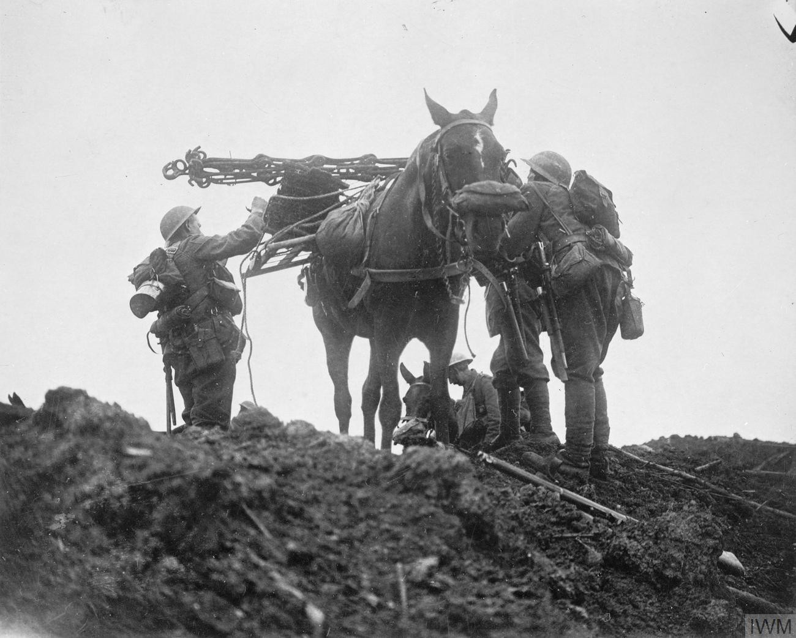
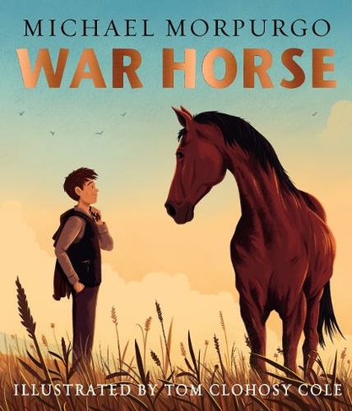
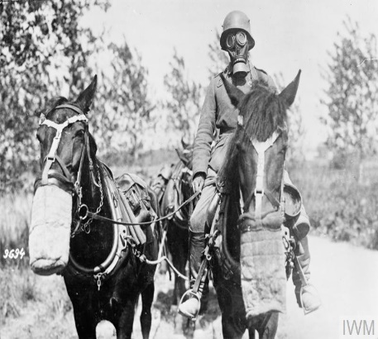
Horses
We are going to tell you about horses in the war and how they helped.
Horses were mainly used for transport. They carried guns and ammunition (bullets and shells) and were better at going over muddy and rough ground than motor vehicles.
Did you know horses had their own gas masks?
Sometimes horses were used to collect and carry food, and a lot of the time they were used to ride on.
Horses were also useful for pulling loads and moving machinery. Sadly a lot of horses were killed in WW1 and WW2.
There is a very famous book called ‘War Horse’. It was written by Michael Morpurgo and tells the story of a young man and his horse in the war. You may have read it or seen the film of it.

Slide 16
Horses
Horses worked hard and often did not get enough food to keep their strength up.
The soldiers loved their horses and did their best to look after them.
Some of the horses got very thin.
On Rafe’s picture you can clearly see the horses ribs!

Slide 17
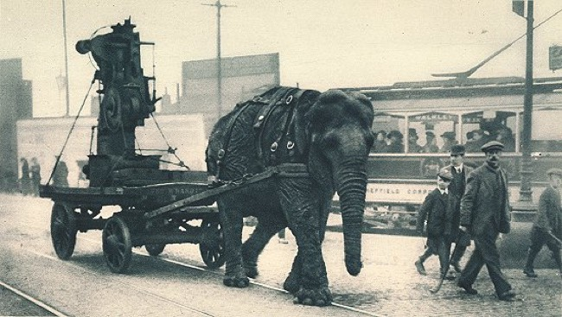
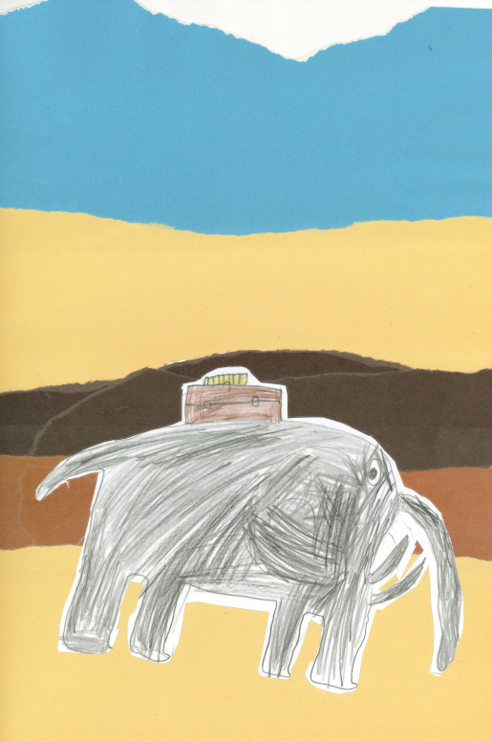
Elephants
Elephants were used to transport munitions in
Hamburg, and a circus elephant called Lizzie was used for the same job in Sheffield.
The elephant in our collage is carrying a box of ammunition.

Slide 18
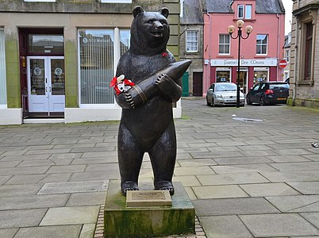
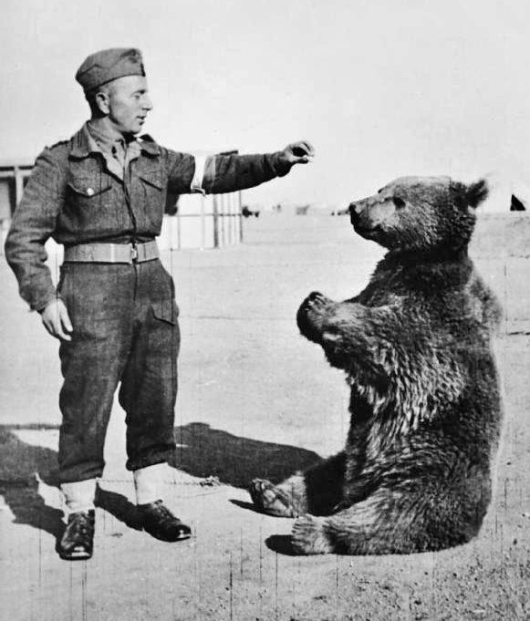
Bears
Different countries used bears for many different things. Some bears carried heavy loads and some were mascots.
One famous bear was called Wojtek and he grew to over 6 feet tall. Did you know that Wojtek means small?
Wojtek travelled from Poland to Italy and he helped by carrying heavy shells and boxes of ammunition.
Wojtek was made a Private in the army because if you were a member of the army then you had a food ration and this meant Wojtek got fed! He was also given a medal for being brave.
After the war Wojtek travelled to Scotland and he lived in Edinburgh Zoo.

Slide 19
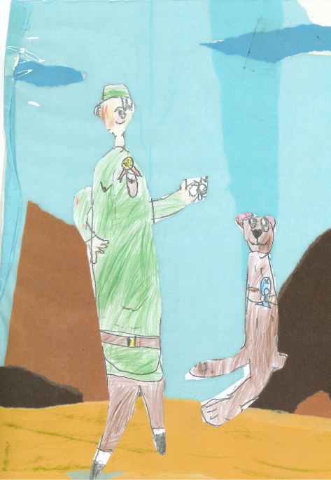
There is a statue of Wojtek in Scotland near Edinburgh zoo where he lived until he died. He is carrying ammunition like he did in the war.
Our picture shows Wojtek getting a medal for being very brave.

Slide 20
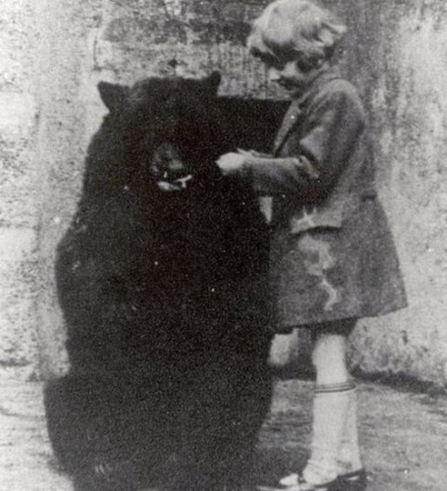
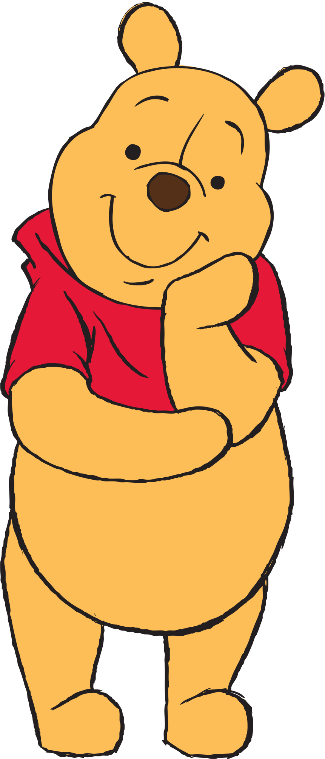
Winnie the Pooh
Winnipeg, known as Winnie for short, was an American black bear who was a mascot for Canadian soldiers.
When they went back to Canada the soldiers gave Winnie to London Zoo in 1914.
The writer AA Milne took his son Christopher Robin to see Winnie at the zoo.
Christopher really liked Winnie and it inspired his father to write the famous stories about Winnie the Pooh.

Slide 21

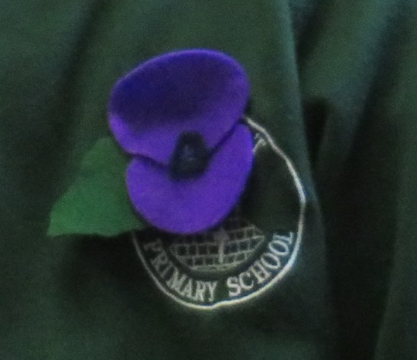


Our Poppies
For our assembly we made our own purple poppies.
We cut the petals and leaves out of felt and sewed them together with a black centre.

Slide 22
